Slide 1
Chapter 4: Promoting Inclusive Culture
Chapter Objectives:
After the successful completion of this chapter, you will be able to:
Define inclusive culture
Discus the dimensions of an inclusive culture
Evaluate policy related to an inclusive culture
Explain the process of building community for an inclusive culture
Discus approaches to establishing an inclusive culture
Discuss inclusive values
Explore and discuss indigenous inclusive values
Evaluate existing inclusive practices

Slide 2
4.1. Definition of Inclusive Culture
Inclusion is a sense of belonging, connection, and community at work.
Inclusive organizations help people feel welcomed, known, valued and encouraged to bring their whole, unique selves to work.
Culture:- the ideas, customs, and social behavior of a particular people or society.
An inclusive culture involves the full and successful integration of diverse people into a workplace or industry.
They encompass both formal and informal policies and practices, and involve several core values:
Representation:- the presence of people with disabilities across a range of employee roles and leadership positions
Receptivity:- respect for differences in working styles and flexibility in tailoring/modifying positions to the strengths and abilities of employees and
Fairness: equitable access to all resources, opportunities, networks, and decision-making processes.

Slide 3

4.2. Dimensions of Inclusive culture
Universal Design:- construction of structures, spaces, services, communications, and resources that are organically accessible to a range of people with and without disabilities, without further need for modification or accommodation.
2. Recruitment, Training, & Advancement Opportunities
Recruitment: effective recruitment of PWDs involves two components:
Accessible outreach and hiring practices:- making sure that outreach materials, networking, recruitment sites, communications, and application processes all include a range of accessible options, or are free of barriers that might inhibit people with disabilities from participation
Targeted recruitment of workers with disabilities:- targeted recruitment enables employers to reach and interview qualified people with disabilities.
Training:- plays a dual role in the creation of inclusive workplace culture.
Advancement: targeted mentoring and coaching programs specifically assist employees with disabilities.

Slide 4
3. Workplace Accommodations and Accessibility: Policy & Practice
When assessing the effectiveness of existing accommodations policies, employee experiences can be described based on two measures of equity.
the perception of procedural justice:- employees with disabilities perceive the accommodations policy as fair, accessible, and functional.
Interactional justice:- refers to the experience of feeling that the managers or colleagues with whom one is interacting are behaving fairly, reasonably, and respectfully.

Slide 5
4.3 Building inclusive community
An inclusive community:
Does everything that it can to respect all its citizens, gives them full access to resources, and promotes equal treatment and opportunity.
Works to eliminate all forms of discrimination.
Engages all its citizens in decision-making processes that affect their lives.
Values diversity and response quickly to racist and other discriminating incidents.
An inclusive society aims at empowering and promoting the social, economic, and political inclusion of all, irrespective of age, sex, disability, race, ethnicity, origin, religion, economic, or another status.

Slide 6
4.4 The importance of building an inclusive community
It is important to consider the motivation behind an individual, a group, or a community's desire to build an inclusive community because the motivation affects the following:
Types and sequence of strategies selected: if there were a crisis, you might have to start with a strategy that transforms the conflict.
Resources available: more resources could be mobilized if the motivation came from a large institution or a local foundation.
Amount of support and obstruction: if the dominant group in the community is just as motivated as any other group, there is likely to be more support. If, however, the dominant group has no interest in changing the status quo, there are likely to be more barriers.
Rate of progress: if the major leaders and groups support the effort, progress is likely to be faster.
Expected outcomes: if the goal is to raise awareness, everyone involved is likely to be satisfied if they learned new things about other groups. If the goal is to promote fair treatment of every group, everyone involved is more likely to be satisfied with policy change

Slide 7
4.5. Characteristics of an Inclusive Community
Integrative and cooperative:- bring people together and are places where people and organizations work together.
Interactive:- have accessible community spaces and open public places as well as groups and organizations that support social interaction and community activity, including celebrating community life.
Invested:- are places where both the public and private sectors commit resources for the social and economic health and well-being of the whole community.
Diverse:- welcome and incorporate diverse people and cultures into the structures, processes, and functions of daily community life.
Equitable:- make sure that everyone has the means to live in decent conditions (income support, employment, good housing) and the opportunity to develop one‘s capacities and to participate actively in community life.

Slide 8
Accessible and Sensitive:- readily available and accessible supports and services for the social, health, and developmental needs of their populations and provide such supports in culturally sensitive and appropriate ways/essential services, etc.
Participatory:- encourage and support the involvement of all their members in the planning and decision-making that affects community conditions and development
Safe:- ensure both individual and broad community safety and security so that no one feels at risk in their homes or moving around the neighborhood and city.

Slide 9
4.6. Means of establishing an inclusive culture
There are four key inclusive leadership behaviors:
Empowerment: enable team members to grow and excel by encouraging them to solve problems, come up with new ideas and develop new skills.
Accountability: show confidence in team members by holding them responsible for aspects of their performance that are within their control.
Courage: stand up for what you believe is right, even when it means taking a risk.
Humility: admit mistakes, learn from criticism and different points of view, and overcome your limitations by seeking contributions from team members.

Slide 10
How is inclusive culture established? (5 ways establishing inclusive culture)
Consider what you want to achieve and what the benefits will be: the process involves looking at your organization: its size, the type of work it does, where it is located, who it employs, who uses its services, and what its goals are; and thinking about how it could become more inclusive.
Undertake an inclusion review of your workplace:- when reviewing inclusion and equality in your organization, you should consider the following areas:
The demographics of your organization and customer base:- age, gender, ethnic group, religion or belief, sexual orientation, disability, etc.
Your formal policies and procedures:- the formal policies and practices of your organization thought about inclusion, human rights, and equality.
3. Decide where work is needed and create an action plan:- set out the key changes you would like to make as a result of your review.
Prioritize these changes to help you decide where to start.
Actively involve all employees
Build a culture of inclusion and respect
Take an inclusive approach to recruitment, promotion and development

Slide 11
4. Communicate the plan with staff and put the plan into action
Actively involve all groups of employees:- respect and opportunity for all, it is essential that everyone in the organization, from senior management to the most junior staff, is engaged with and involved in the process of creating this culture, and feels that their opinions and experiences are valued.
Participation and consultation:- staff and any unions or other employee representatives should be consulted at different stages in the plan‘s implementation, in order to get their feedback on the progress being made.
Ways of consulting and involving employees and their representatives
Staff surveys:- can be used to gather information on a range of subjects, including the make-up of the workforce, responses and attitudes towards equality and human rights issues, and levels of job satisfaction among employees.
Focus groups:- provide more opportunities for in-depth consultation and debate with a smaller number of employees.
Engagement with employee networks and forums can utilize an important representative voice of staff from minority groups and can provide useful input into policies and action plans.
5. Review, monitor and evaluate the plan’s impact and use what you find to plan future action

Slide 12

4.7. Ten Characteristics of an Inclusive Organization
It accepts diversity and inclusion as a way of life:- many cultures, traditions, beliefs, languages, and lifestyles are prevalent in both the workforce as well as the customer populations and are respected without judgment.
It evaluates individual and group performance on the basis of observable and measurable behaviors and competencies:- employees have a clear understanding of their roles and responsibilities.
It operates under transparent policies and procedures:- there are no hidden rules of behavior that may be apparent to some groups and unknown to others.
It is consistent in its interactions with everyone:- there is no double standard. Rules are applied appropriately and regularly throughout the institution.
5. It creates and maintains a learning culture:- mentoring programs are robust, and include both formal and informal systems that meet the individual learning needs of all employees

Slide 13
6. It has a comprehensive and easily accessible system of conflict resolution at all levels:- it recognizes that conflict is inevitable in a complex multicultural organization, and it has systems in place to address conflict in a non-confrontational manner that respects the dignity and confidentiality of all parties.
7. It recognizes that it is part of the community that it serves:- an inclusive organization is an active participant in community activities, and plays a vital role in addressing its needs.
8. It lives its mission and core values:- people work for an organization because they believe in its purpose and goals.
9. It values earned privilege over unearned privilege:- employees are recognized for their actions and accomplishments, not simply because of their titles or degrees.
10. It accepts and embraces change:- an inclusive organization recognizes that current and past practices must constantly be reviewed and updated to meet the changing demands and needs of the industry, workforce, and customers.

Slide 14
4.8. Inclusion Values
Inclusion is most importantly understood as putting inclusive values into action.
Inclusion is a commitment to particular values which accounts for a wish to overcome exclusion and promote participation.
The seven Pillars of Inclusion:
Access:- access explores the importance of a welcoming environment and the habits that create it.
Attitude: attitude looks at how willing people are to embrace inclusion and diversity and to take meaningful action.
Choice:- choice is all about finding out what options people want and how they want to get involved
Partnership:-inclusive values are appreciating diversity, equality, and equity, cooperativeness, participation, community, and sustainability are examples of inclusive values that are fundamental for successful inclusive education

Slide 15
Communication:- communication examines the way we let people know about the options to get involved and about the culture.
Policy:- policy considers how an organization commits to and takes responsibility for inclusion
Opportunity:- opportunity explores what options are available for people from disadvantaged backgrounds.

Slide 16
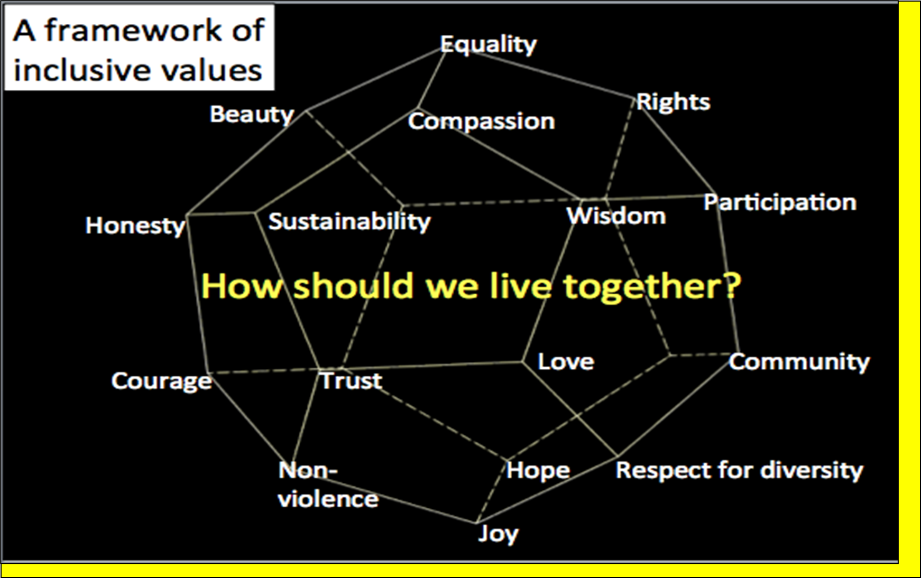

Slide 17
4.9. Indigenous inclusive values and practices
The term “indigenous” refers to a better understanding of, and respect for, indigenous cultures and develops an enriched appreciation of the existing cultural heritage.
Indigenous ways of knowing were often discounted and discredited as non-scientific because they were rooted in the story of the people, their language, culture, art, mythology, and spirituality.
Incorporating indigenous ways of learning into educational practices has the potential to benefit both Indigenous and non-Indigenous learners.
The 21st-century skills needed in the modern curriculum include collaboration, creativity, innovation, problem-solving, inquiry, multicultural literacy, etc.

Slide 18
4.10. What is indigenous inclusion?
Indigenous inclusion is an organizational state that is embraced as a cultural norm, with enterprise-wide workplace strategies as well as a culture that invites the full participation of indigenous people in all aspects of business operations.
It is where leadership and employees are welcoming of indigenous people, their experience and outlooks, where diversity is valued, the spirit of reconciliation has been embraced and calls to action have been acted on in meaningful ways.

Slide 19
4.11. Features of an indigenous inclusion:
Inclusion has been embraced as a core competency and embedded into the organizational culture;
Companies share their organization‘s experience and achievements with inclusion and explain how it has helped their performance;
Human rights and responsibilities are promoted and respected.
Employees are free of concerns related to basic equity issues;
Comprehensive Indigenous procurement, recruitment, and corporate social responsibility strategies have been developed as part of an enterprise-wide coordinated approach;
Indigenous people are employed and retained in all areas of the organization including the senior leadership and executive positions;

Slide 20
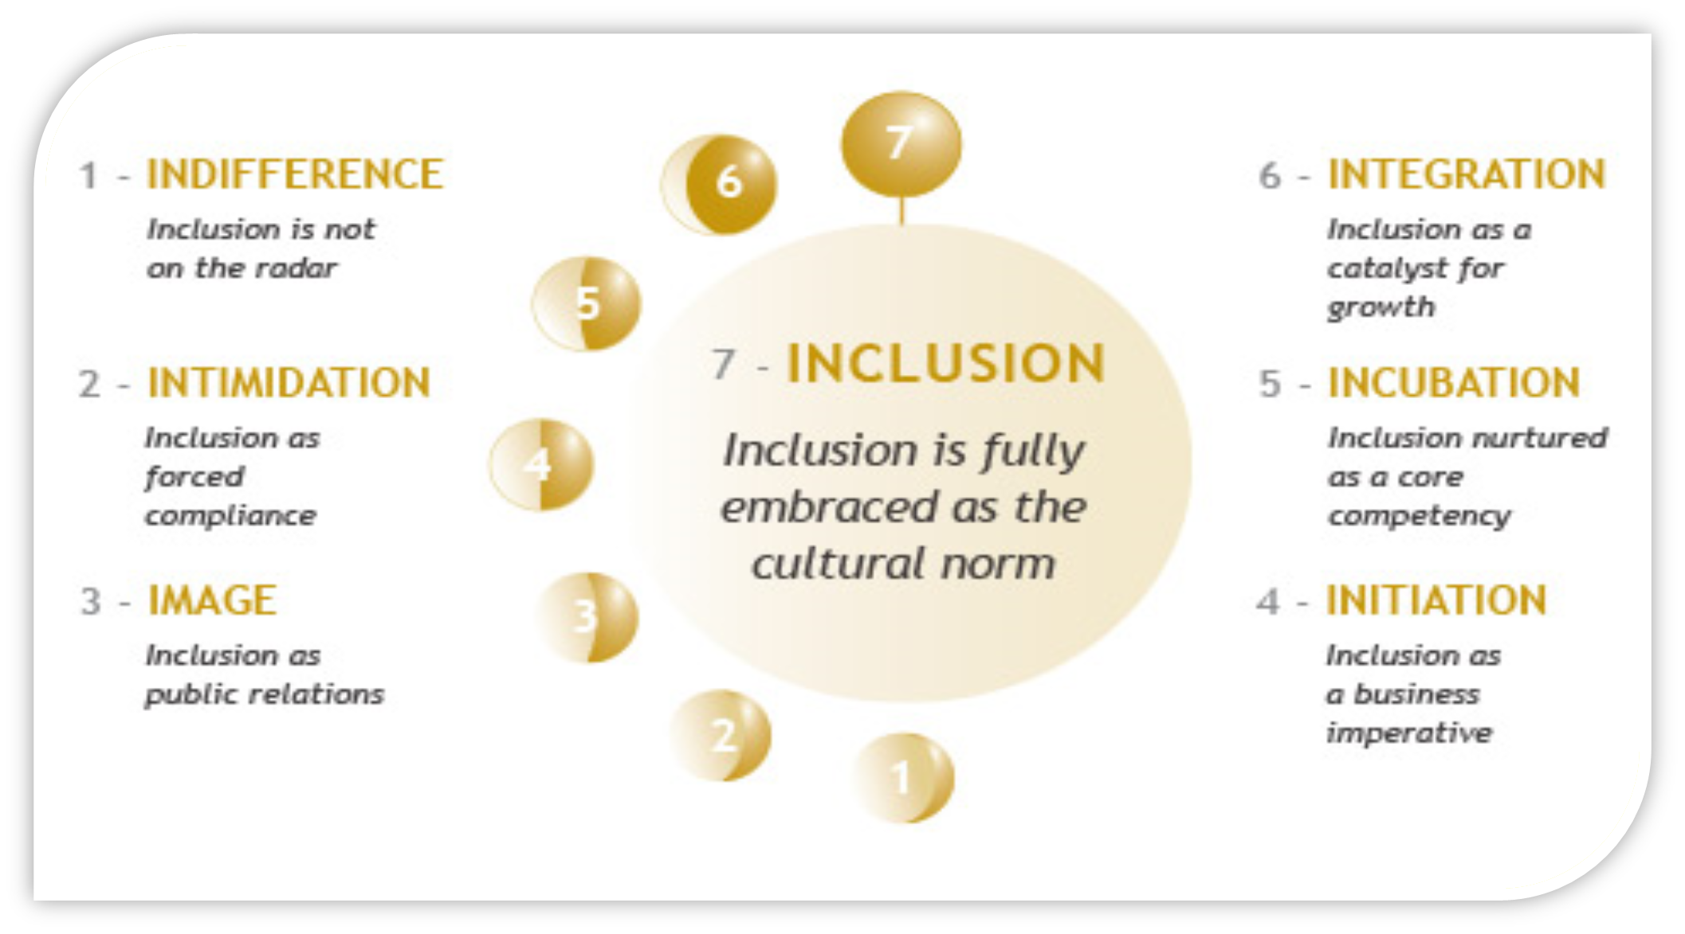
A seven stage model to indigenous inclusion:

Slide 21
Stage 1 – Indifference
Inclusion is not on the radar screen
Denial forms the basis of workplace diversity.
Employee morale is never a priority.
Discrimination and harassment go unchallenged
Stage 2 – Intimidation
Inclusion as forced compliance
This company acts wholly from fear.
The minimal legal requirement is the high bar.
All important actions are reactive rather than proactive.
Legal obligation becomes the surest or inevitable guide to Indigenous inclusion.
Stage 3 – Image
Inclusion as public relations
This company prizes HR – so long as it serves PR.
What value exists in Indigenous employees – how can they be showcased/exhibited?
Wholly reactive, but to the carrot rather than the stick.
External perceptions become the surest guide to Indigenous inclusion.
Stage 4 – Initiation
Inclusion as a business imperative/authoritative
A change agent has been roused/provoked by the values of inclusion.
That person presents other managers with a business case for inclusion.
A nucleus of manager demand drives executives to move the effort forward.
The organization begins a self-assessment: how can it become more inclusive?

Slide 22
Stage 5 – Incubation Inclusion nurtured as a core competency
The highest executives commit to the path of inclusion.
Inclusion is regarded as a ‘core competency, necessary for organizational growth.
The business case for Indigenous inclusion is translated into policies and practices.
The company organizes training and other efforts to grow an inclusive culture.
Stage 6 – Integration Inclusion as a catalyst for growth
The company’s goals are permanently integrated with its inclusion goals.
Employees have high morale and show a high degree of engagement.
Long-term strategies drive internal and external Indigenous relations.
The organization vigorously promotes inclusion in other organizations.
Stage 7 – Inclusion is fully embraced as the cultural norm
This highly productive workplace is dedicated to continuous improvement.
The corporate culture is one of unflagging/continuous commitment to inclusion.
This is the company of choice for the very best Indigenous talent

Slide 23
4.12. Types of indigenous inclusion policies
Inclusive practice: is an approach to teaching that recognizes the diversity of students, enabling all students to access course content, fully participate in learning activities and demonstrate their knowledge and strengths at assessment.
Inclusive practice is about the attitudes, approaches strategies talent to ensure that people are not excluded or isolated.
Inclusive practice involves having an understanding of the impact that discrimination, inequality, and social exclusion can have on an individual.

Slide 24

4.13. Inclusive practices in education are based on seven principles:
Diversity enriches and strengthens all communities
All learners‘ different learning styles and achievements are equally valued, respected, and celebrated by society
All learners are enabled to fulfill their potential by taking into account individual requirements and needs
Support is guaranteed and fully resourced across the whole learning experience
All learners need friendship and support from people of their own age
All children and young people are educated together as equals in their local communities
Inclusive teaching strategies refer to any number of teaching approaches that address the needs of students with a variety of backgrounds, learning modalities, and abilities.

Slide 25
Chapter summer questions
What does mean inclusive culture?
What are the dimensions of inclusive culture?
Explain the process of building community for an inclusive culture
What are the approaches to establishing inclusive culture?
What are the inclusive values?
What are the indigenous inclusive values
Evaluate existing inclusive practices in Ethiopia

